Slide 1
VIZ1, Session 4
Interactivity

Slide 2
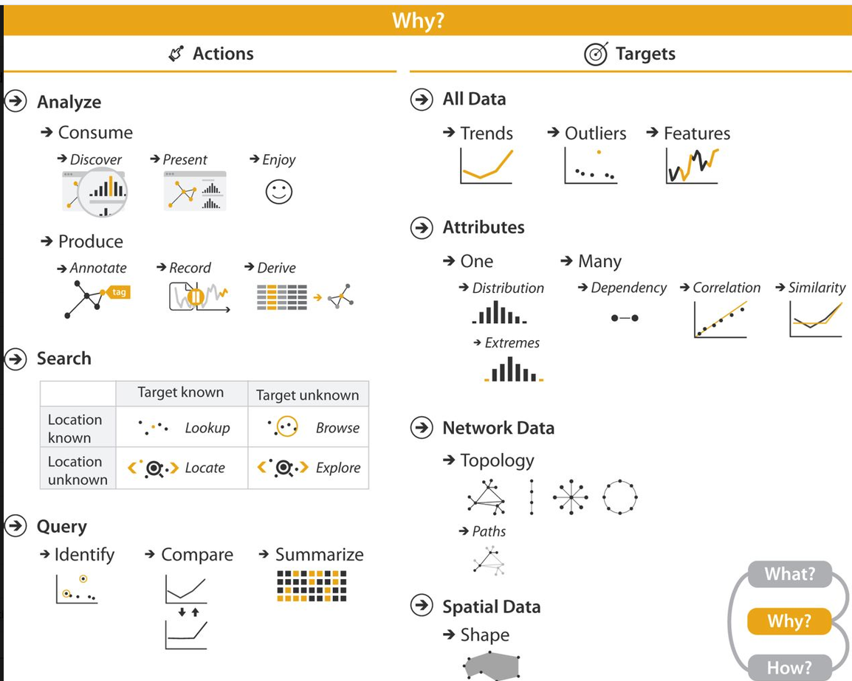
Why interaction?

Slide 3
When to use interaction
What is the usage situation?
  Repeated or one-time?
  Quick overview or deep contemplation?
  Mobile phone or large, mounted display?
Who is the user?
  Tech-savvy or casual?
  How is the domain knowledge?

Slide 4
Kinds of interaction
Selecting data
  Using click/tap or hover
  To display more information
  To change or add information
Navigating data
  Filtering
  Zooming
    Geometric
    Semantic
  Aggregation

Slide 5
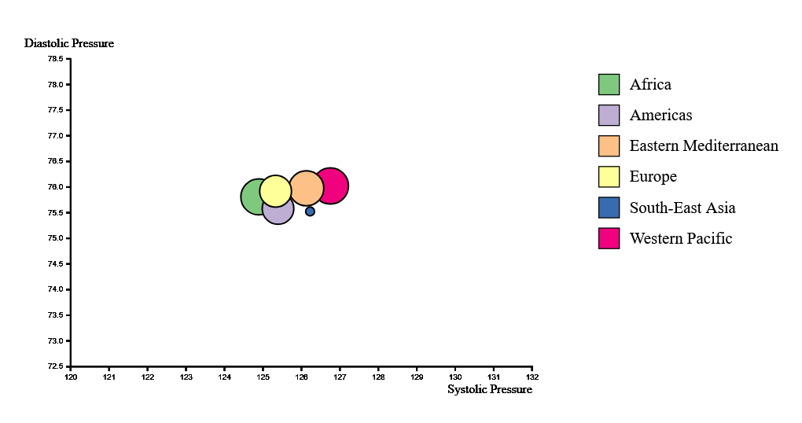
Example: Selecting

Slide 6
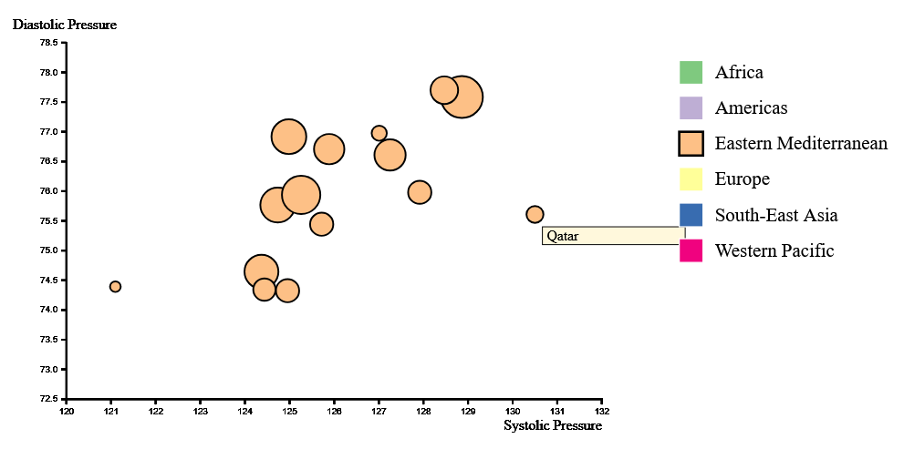
Example: Selecting

Slide 7
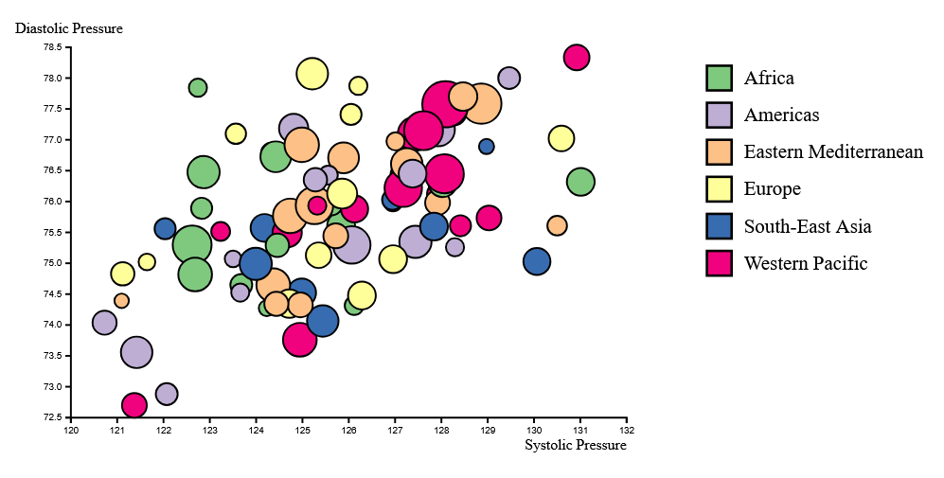
Example: Filtering

Slide 8
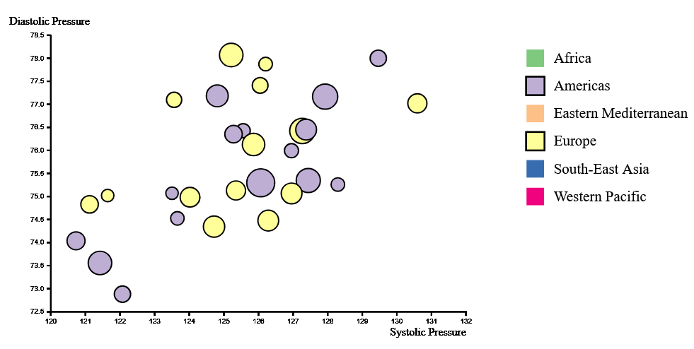
Example: Filtering

Slide 9
Interaction: The Model-View-Update pattern

Slide 10
Model, DOM and Viz
The state of the app consists of three elements:
Model
  The data you need to visualize
  Pre-processed, aggregated, sorted, …
DOM
  References to the (SVG) elements where you visualize
  To avoid having to look them up by id or class
Viz
  Scales
  Stacks
  Area generators
  …

Slide 11
Creating the state
You can also pass around model, dom, viz as individual variables
The update method ensures that all functions work on the same state
Note the use of state.model instead of this.model
const model = createModel(await loadData())
const dom = createDOM(model)
const viz = createViz(model)
const state = {
model, dom, viz,
update(patch) {
state.model =
{...state.model, ...patch}
view(state)
}
}
view(state)

Slide 12
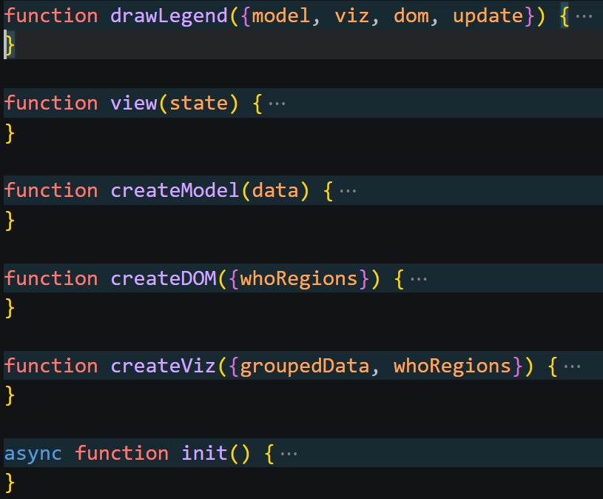
Code structure
In this example, events are handled in view
You could also make a createEvents function
drawLegend is an example helper function called from view
Note how it destructures the state

Slide 13
Event handlers
Not too different from addEventListener
But you also get the data attached to the element
Remember that d3 attaches a __data__ property to all elements
legend
.selectAll("rect")
.data(d => d)
.join("rect")
/* attributes */
.on('click', (e, d) => {
update(/* patch */)
e.stopPropagation()
})

Slide 14
Tip: Duplicated elements
Beware of calling svg.append() after every user interaction
  It will duplicate the elements
Either:
  Create the element once in createDOM
Or:
  Use a data join (right)
  Note the singleton array
svg.selectAll("#legend")
.data([whoRegions])
.join("g")
.attr("id", "legend")
.attr("transform",
"translate(600, 100)")

Slide 15
Transitions
Small animations to get from one visualization to the next
  Fade-in/out
  Grow/shrink
  Move
Bringing attention to the change
Helping track the change
  Eyes beats memory
Giving a “sleeker” look
  Beware of distracting the user

Slide 16
Transition, duration, ease
Transition:
  The following changes should be gradual
  Opacity, not translate
Duration
  The length of the transition in milliseconds (default 250)
Ease
  How the transition should move through time
dom.toolTip
.attr('transform’,
`translate(${x}, ${y})`)
.transition()
.duration(150)
.ease(d3.easeQuadOut)
.style('opacity', 1)

Slide 17
Ease
Describe how fast the transition goes at different times
easeLinear
  (Default) The transitions always moves at same speed
  Can seem abrupt
easeQuadIn / easeCubicIn
  Moves slowly first, then faster
  Grabs attention, then shows the transition
easeQuadOut / easeCubicOut
  Opposite of easeQuadIn
  Shows the information quickly with a softer finish
easeQuadInOut / ease CubicInOut
  Seems like a “softer” easeLinear
See https://d3js.org/d3-ease

Slide 18
Demo

Slide 19
Enter, update, exit
For finer control
The code under 1)
Really is the code under 2)
Enter is the data added since last update
Update is the changed data
Exit is the data deleted since last update
// 1)
diagram.selectAll(“circle”)
.data(d)
.join(“circle”)
// 2)
diagram.selectAll(“circle”)
.data(d)
.join(
enter =>
enter.append(“circle”),
update => update,
exit =>
exit.remove())

Slide 20
Enter, update, exit example
diagram.selectAll("circle")
.data(filteredData, d => d.key)
.join(
enter => enter.append("circle")
.style('opacity', 0)
.transition()
.style('opacity', 1),
update => update,
exit => exit
.transition()
.style('opacity', 0)
.remove())

Slide 21
The importance of the key function
In JavaScript,
  {country: 'DK', age: 37} != {country: 'DK’, age: 37}
  There is no equals() method
Enter, update and exit sets would be determined by array index
  This makes no sense
By adding a key function, you tell D3 how to identify data

Slide 22
Demo

